Slide 1
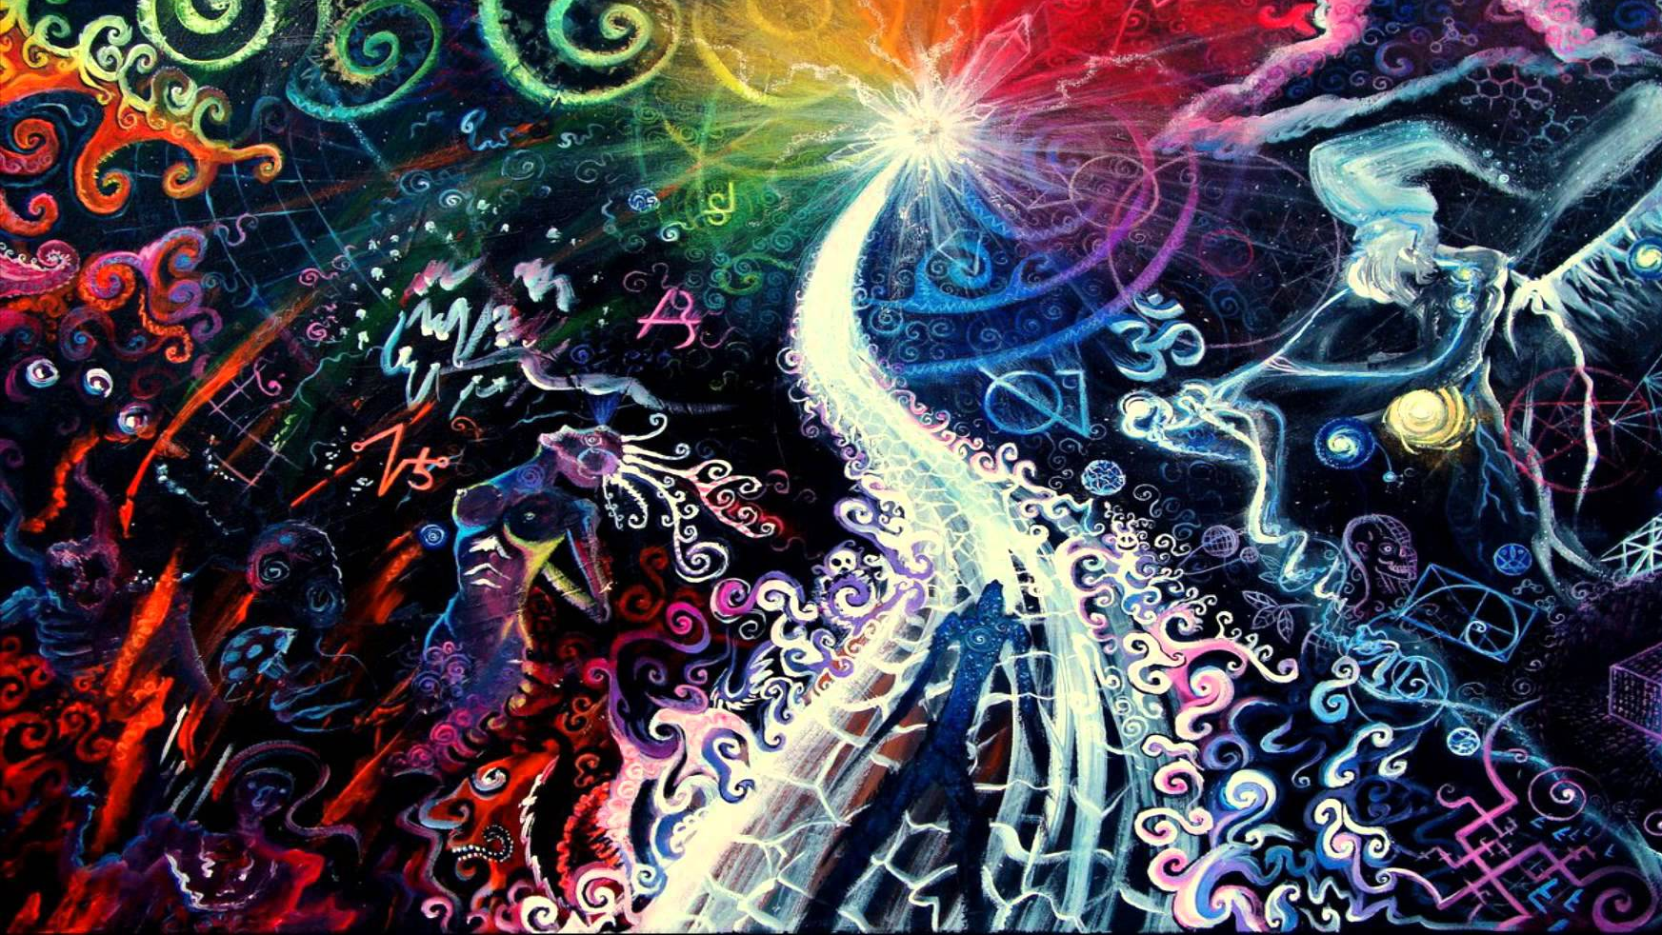
God’s Freedom
Romans 6:15-23

Slide 2

Nietzsche's Freedom
“Individual Freedom”
“My Freedom!”
(Loneliness)
“The Superman” (Overman)
Notes:
** “Indiv/My” = “AWAY w/ RELIG”
**Loneliness = “MY TRUTH”
**Superman = NEW ETHICS→ Gud=POWER, Bad=XIANITY

Slide 3

God's Freedom
The Universal Source of Freedom
2 Corinthians 3:17 Now the Lord is the Spirit, and where the Spirit of the Lord is, there is liberty.
Notes:
** Universal = G. Created FREEDOM / Free Will
** 2Co.3 → LIBERTY = Proof of G’s Presence
~Luk Like Ch. History!

Slide 4
God's Freedom
“Our Freedom” NOT “My Freedom!”
Love-Based Freedom
Galatians 5:13 For you were called to freedom, brethren; only do not turn your freedom into an opportunity for the flesh, but through love serve one another.
Galatians 5:15 But if you bite and devour one another, take care that you are not consumed by one another.
Notes:
**OUR, ~MY → Lonely Freedom=MEANINGLESS
** Love=UNITY/Mutual Promotion
Gal.5:13 Xian Freedom = PURPOSE-Driven
** 5:15 = OTHERWISE → Freedom=ANARCHY

Slide 5


Rom. 5-7 “Old Man” v. “New Man”
Neitzsche’s Freedom
God’s Freedom
“MY Way”
Rebellion (no real God)
“OUR Way”
Via God’s Leadership

Slide 6
Romans: “God-Counseling”
Humankind’s Problems with God
We don’t need God.
God’s Problem with humankind
Sin (=Rebellious Hearts)
We’re good! (enough)
God contradicts us.
Romans 1:18 …who suppress the truth in evil/mean ways
Romans 1:21 humankind knew there is a God, but they did not honor Him as God or give thanks…
Romans 2:4 Humankind thinks lightly of the riches of His kindness and tolerance and patience…
Romans 3:23 for all have rebelled and fall short of the glory of God,
Romans 5:17 the rebellion of this one man, Adam, caused death to rule over humankind…

Slide 7
Romans: “God-Solutions”
Religions
RULES / Rituals
Relationship
God-Engineered
By GRACE
Forgiven & accepted totally
We’re good! (enough)
Human-Engineered
Rebellion (me alone)
Love (trusting God)
Notes:
Relig = What Nietch’s Problem
**Rebellion=RELIG. /Relat=Trusting G=LOVE

Slide 8
Rom. 6: The Religious Solution to Pollution
Romans 6:12 Therefore do not let sin reign in your mortal body so that you obey its lusts,
Romans 6:14 For sin shall not be master over you, for you are not under law but under grace.
It Don’t Work
Arbitrary Rightness
Hypocrisy
Therefore
Just DO it!
You CAN BE Perfect!
STOP SINNING!
BUT…?
“You are not under LAW, but under GRACE”
Notes:
2 WAYS 2 READ Rom. 6:12,14
** STOP ** BUT ** ~Work / Arbit. /Hypoc

Slide 9
Rom. 6: God’s Solution to Pollution
Meaning:
God put to death the Rebellious Heart.
6:6 knowing this, that our old self was crucified…
6:7 for he who has died is freed from sin rebellion.
Knowing
It’s not what you feel.
It’s knowing what is real.
(i.e., the “Old Man” / “Adamic Nature”)
Notes:
6:6,7 SIN=Rebellion → “Hamartia”= ~Like G.
AP: Rebellion = Human HISTORY
** Means → NEW IDENTITY → Deep/Internal/Spiritual
IL: G ~Scary, ~Threat, ~Dreadful
** “Knowing” = iGen Problem? USA Problem?
==Emotional Problems!!
IL: FEEL = Alienated From G. → REAL= a LIE
IL: Mature v. Immature = Reality v. Feelings

Slide 10
Rom. 6: God’s Solution to Pollution
Meaning:
Living with God
Not against God.
6:11 Consider yourselves to be dead to rebellion, but alive to God in Christ Jesus.
2 Peter 2:21-22 For it would be better for them not to have known the way of righteousness, than having known it, to turn away from the holy commandment handed on to them. It has happened to them according to the true proverb, "A DOG RETURNS TO ITS OWN VOMIT," and, "A sow, after washing, returns to wallowing in the mire."
“Consider”
New Principles, Strengths, Relationships, HOPE
New Weaknesses, Spiritual Enemies, Problems…
Notes:
**Meaning → Every A.M. : “?? WE Gonna Do Today G??”
**Consider = Logizomai → BRAVE NEW WORLD
** 2 Pet. 2 = “Have COMPASSION…” on these IDIOTS

Slide 11
Rom. 6: God’s Solution to Pollution
Meaning:
Our choice is whether to join God’s struggle w/ humankind.
Love v. not-love.
6:13 and do not go on presenting the members of your body to rebellion as weapons of unrighteousness; but present yourselves to God as those alive from the dead, and your members as weapons of righteousness to God.
“Present”
“To stand alongside”
Notes:
v.13 → ~ “Stop Sinning”, ~”DO GOOD” → Convuluted?
**G’s Struggle → I ~Underst. It → AP: Req. HIS Leadership
R Choice = “ALIVE!! READY!!” ~ “I’m so DEAD…” =ZEAL
AP: Ur Choice= a WEAPON = For/Against G = ZEAL
AP: ~ZEAL? → KNOW & CONSIDER
Luv/~Luv = “Righteousness” / “Unright”
**PRESENT = “Here I Stand!! NOT THERE!!”
AP: Parents / Disciplers→ Raise FIGHTERS, ~Protect!
AP: ~BEHAVIOR → HEART-Chng

Slide 12
Rom. 6:15-23 Living in God’s Freedom
Romans 6:14 For rebellion shall not be master over you, for you are not under law but under grace.
STUPID
Just DO it!
You CAN BE Perfect!
STOP SINNING!
Notes:
THUS → v.14 = Rebellion CAN’T Dominate U
~Law= ~RULE-DRIVEN → Grace=RELAT-DRIVEN
**STUPID → Supposed 2b COMFORT, ~CONDEMN!

Slide 13



Living in God’s Freedom
6:15 What then? Shall we rebel because we are not under law but under grace? May it never be!
Notes:
THUS → v.15 = We NEED Fear/Threat Motive??
Fear/Threat/Rules = HUMAN RELIG.
PAUL TA;;UGKHT FREEDOM = 4X ASKED
AP: Even if G ~Accusing Us → WE Do It Anyway
B/C I’m Rebelling Against G’s Grace

Slide 14

God’s Freedom: Self-Perpetuating
6:16 Do you not know that when you present yourselves to someone as slaves for obedience, you are slaves of the one whom you obey, either of rebellion resulting in death, or of obedience resulting in righteousness?
6:17 But thanks be to God that though you were slaves of rebellion, you became obedient from the heart to that form of teaching to which you were committed,
6:18 and having been freed from rebellion, you became slaves of righteousness loving-kindness.
19 I am speaking in human terms because of the weakness of your flesh. For just as you presented your members as slaves to impurity and to lawlessness, resulting in further lawlessness, so now present your members as slaves to righteousness, resulting in sanctification.
Notes:
** “Present” = Everyday Issue → u GET LED…
??Going?? → 1) DEATH 2) CHANGE (i.e., Grwth)
AP: U Get Stuck (=“SLAVES”)
** FROM Heart = G’s Leadership → AP: ~External Behav.
** Free → 2b RIGHTEOUS=LOVE RELATIONSHIPS
** v.19 “Human” → G ~SLAVERY → But: Self-Perpetuating

Slide 15
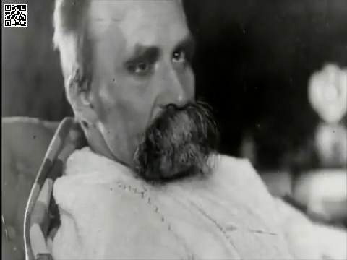
God’s Freedom: LIFE v. Death
20 For when you were slaves of rebellion, you were free in regard to righteousness.
21 Therefore what benefit were you then deriving from the things of which you are now ashamed? For the outcome of those things is death.
22 But now having been freed from rebellion and enslaved to God, you derive your benefit, resulting in sanctification, and the outcome, eternal life.
Hebrews 2:15 Jesus came to free those who through fear of death were subject to slavery all their lives.
Slavery
Stagnation, Shame, Death
Freedom
Growth, Significance, Life
Notes:
** Stagnation=~CHOICES=HURRAY!! → ONLY HUMAN
Shame=EVIL → Death=GUARANTEED=MEANINGLESSNESS
Nietzche = wrong about “no external force”
Slavery=Human Condit → DEATH, MEANINGLESS Outcome
“Fear of Death” = Live 4 2Day
** Grwth=SANCTIF. → Eternal Life=SIGNIF & REAL LIFE

Slide 16
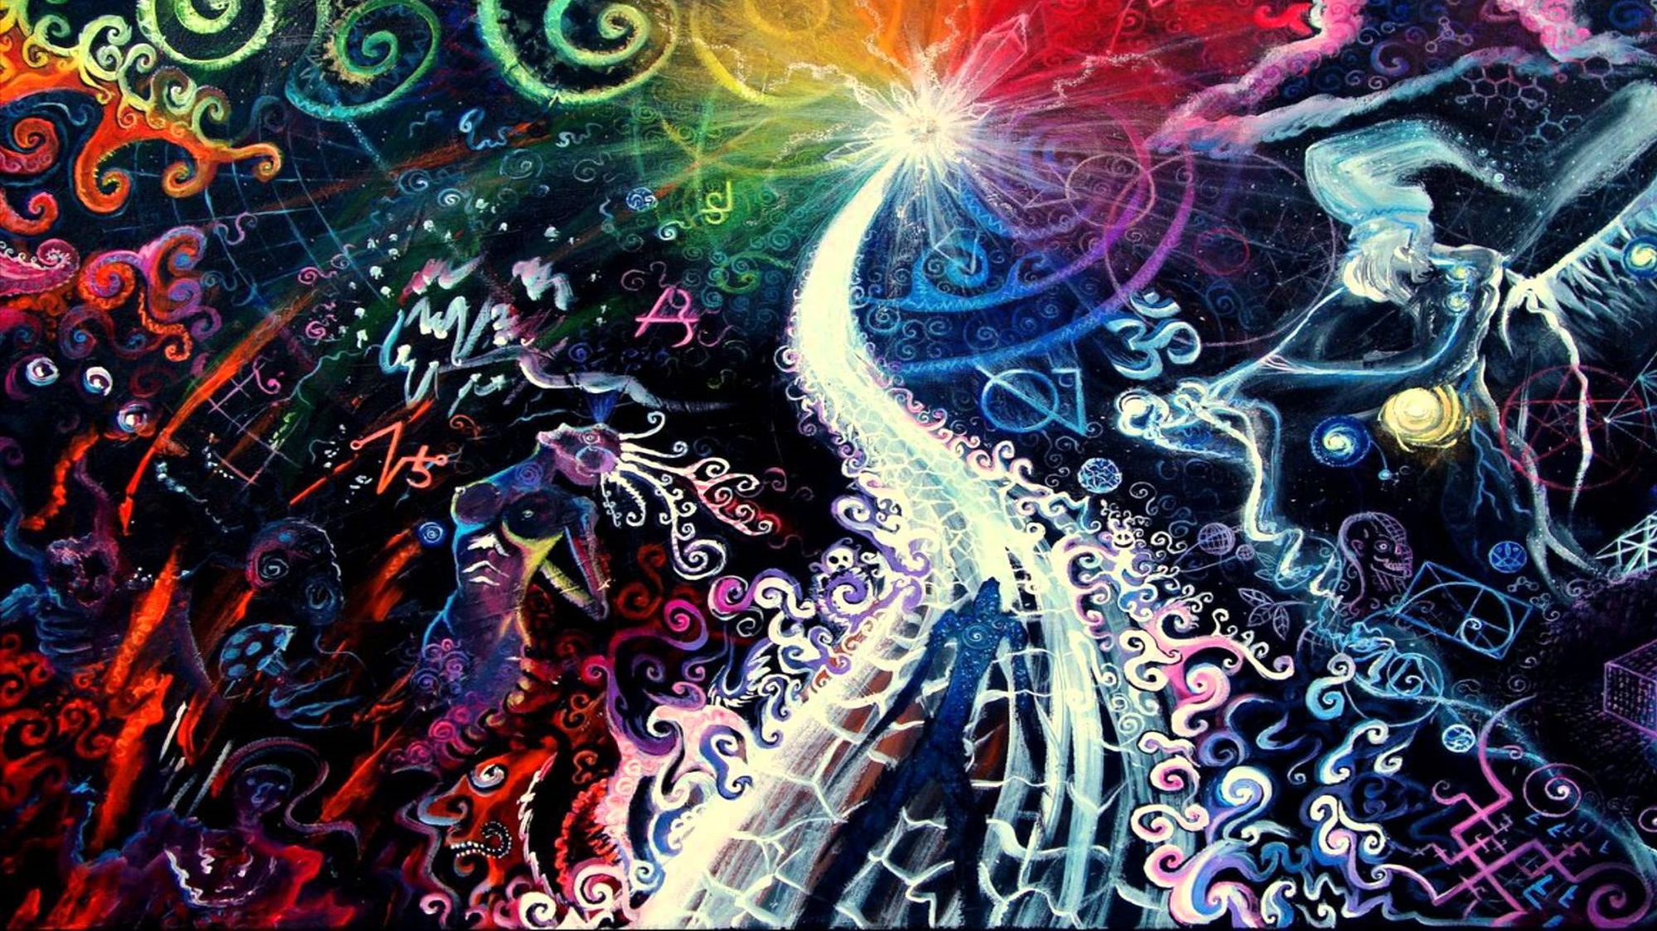
God’s Freedom: LIFE v. Death
23 For the wages of rebellion is death, but the free gift of God is eternal life in Christ Jesus our Lord.
Notes:
Gospel: Your Choice = Life v. Death = 4 FREE, ~RULES/RELIG
**Wild/Crazy = RELAT. W/ G →
Personal, 1:1=SPIRITUAL LIFE=ETERNAL
BUT → Every Step = FREE CHOICE “Present”

